Slide 1

AUTOMATIC FACE RECOGNITION ATTENDANCE SYSTEM

Slide 2

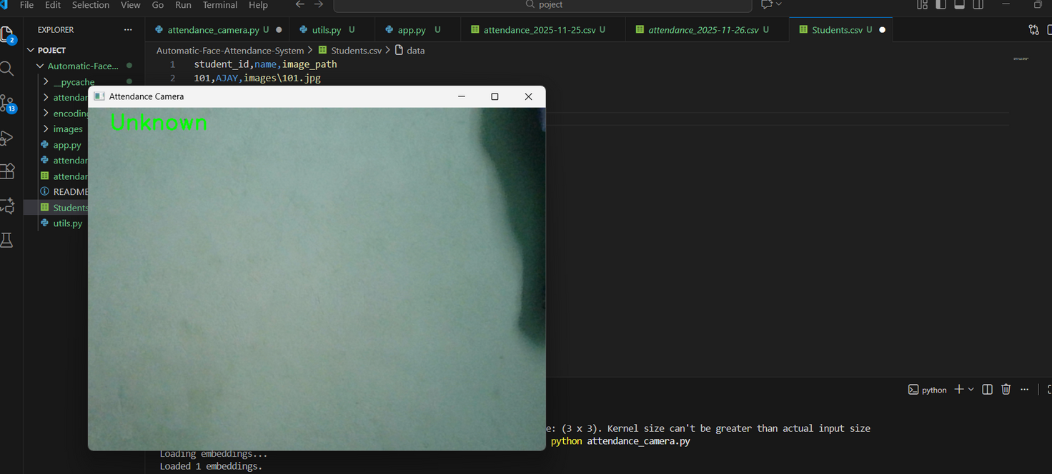
IN THIS
PROJECT
It provides automatic attendance .
Using Face Recognition (MTCNN + FaceNet+Opencv)
The system detects faces, recognizes registered individuals, and records attendance without manual input.

Slide 3

OBJECTIVES
  CAPTURE ATTENDANCE AUTOMATICALLY USING FACE RECOGNITION
  IDENTIFY STUDENTS/EMPLOYEES IN REAL-TIME
  GENERATE ATTENDANCE REPORTS (DAILY, MONTHLY, PER STUDENT)

Slide 4
TOOLS & TECHNOLOGIES
  PYTHON – MAIN PROGRAMMING LANGUAGE
  OPENCV – CAPTURE VIDEO AND PROCESS IMAGES
  FACENET(INCEPTIONRESNETV1)–PRE-TRAINED MODEL FOR FACE ENCODING
  STREAMLIT – WEB INTERFACE FOR ENROLLMENT AND REPORTS
  PANDAS/MATPLOTLIB –DATA HANDLING AND CHARTS

Slide 5
SYSTEM ARCHITECTURE
Enroll Student
Attendance Capture
Reports
Student
detail& photo
live webcam feed
generate CSV &charts
match faces
extract face embedding
download
mark attendance
store

Slide 6
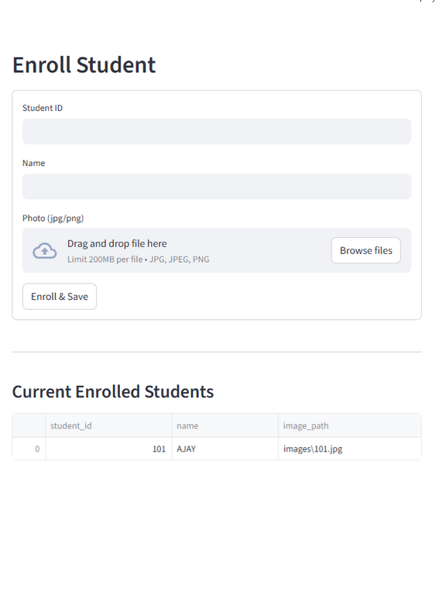
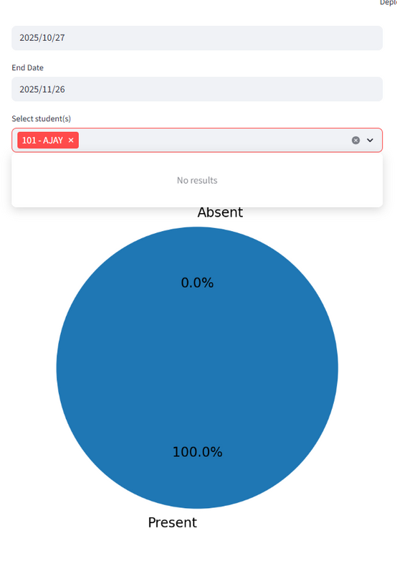
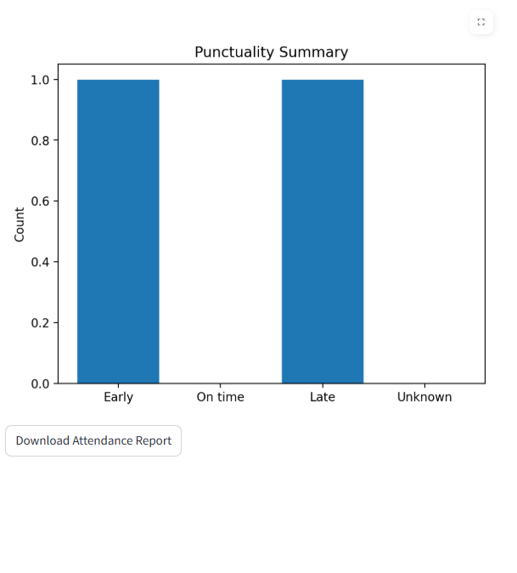
DEMO SCREENS
Enroll Student
Student Report

Slide 7
HOW IT WORKS
  (OPENCV)FACE CAPTURED BY WEBCAM → CONVERTED TO RGB
  MTCNN DETECTS FACE COORDINATES
  INCEPTIONRESNETV1 GENERATES FACE EMBEDDINGS(FACENET FACE)
  COMPARE EMBEDDING WITH STORED EMBEDDINGS
  DISTANCE < THRESHOLD → MARK AS PRESENT (EUCLIDEAN DISTANCE)
  PREVENT DUPLICATE MARKING(IN ATTENDANCE SHEETS)

Slide 8
CONCLUSION
The Automatic Face Recognition Attendance System simplifies the process of tracking attendance by using OpenCV and a CNN-based model to identify students in real time.

Slide 9

THANK YOU
Ajay B.K

